Slide 1



Real-Time Object Detection
FOR AUTONOMOUS VEHICLES
DEPI Graduation Project
Presenter: Nizar Hussien (Team Lead)
December 2025
DEPI Graduation Project | Real-Time Object Detection Slide 1

Slide 2






Project Concept
The Problem
The Solution
Unique Value
Autonomous systems lack reliable environmental perception in adverse conditions (low light, fog), creating safety risks.
A real-time YOLO detection model optimized for edge deployment, to identify pedestrians & vehicles with low latency.
High-speed detection optimized for real-time driving environments Engineered for < 200ms latency,
DEPI Graduation Project | Real-Time Object Detection Slide 2

Slide 3
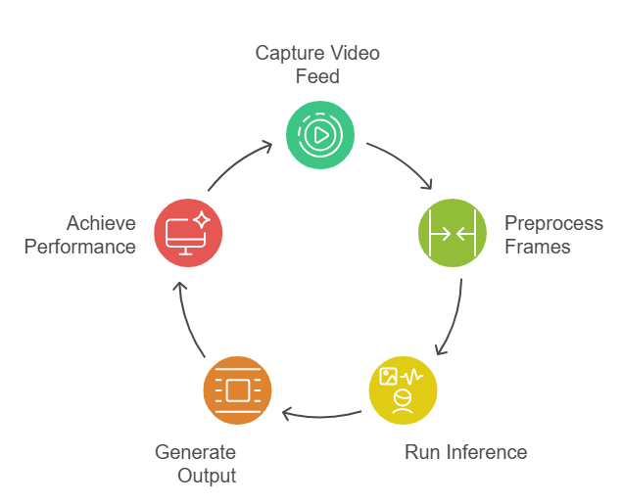

Model Architecture & Data Flow
Inference Pipeline (Core Focus)
Input: Live Video Feed from vehicle cameras.
Preprocessing: Frame normalization and resizing (640x640).
Detection: YOLOv8 model runs inference on the frame.
Output: Structured data (Bounding Boxes and Class Labels).
Performance: Achieving fast inference for real-time operation.
DEPI Graduation Project | Real-Time Object Detection Slide 3

Slide 4


Target Users & Features
Primary User
Key Features
Low Latency: Optimized to respond in < 200ms.
The Autonomous Vehicle System:
Requires instantaneous, machine-readable perception data to make life-critical decisions without human intervention.
10-Class ID: Pedestrians, Cars, Traffic Lights, etc.
High mAP: Maximizing Mean Average Precision (>90%).
Robustness: High accuracy in diverse conditions.
DEPI Graduation Project | Real-Time Object Detection Slide 4

Slide 5
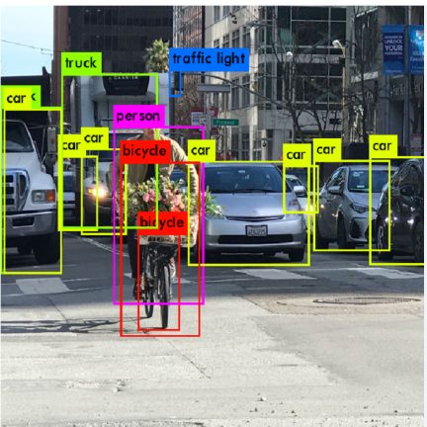

Data Strategy & Processing
Dataset: COCO-2017 Subset
We filtered the massive COCO dataset to focus on 10 driving-critical classes.
Pipeline Implementation
Filtering: Python script extracts only relevant images.
Normalization: Converts COCO [x,y,w,h] to YOLO format.
Config: Automatically generates data.yaml for training.
Augmentation: Applied during training to simulate weather.
DEPI Graduation Project | Real-Time Object Detection Slide 5

Slide 6





Technology Stack
Core & ML
Data & Tools
Python (Main Language)
Pandas & NumPy (Data Handling)
YOLOv8 (Ultralytics Framework)
OpenCV (Image Processing)
PyTorch (Engine)
Git (Version Control)
DEPI Graduation Project | Real-Time Object Detection Slide 6

Slide 7



Performance KPIs
The model is optimized to meet strict real-time safety metrics.
Metrics achieved on the validation dataset during training.
< 200ms
> 90%
Target Latency
mAP (Accuracy)
Training parameters: Image size **640x640**, Batch size 16.
DEPI Graduation Project | Real-Time Object Detection Slide 7

Slide 8






Milestones & Deliverables
05/11
Data Collection
15/11
Model Training
22/11
Real-Time Testing
28/11
MLOps Monitoring
30/11
Final Delivery
Final deliverables include the working source code, and comprehensive technical documentation.
DEPI Graduation Project | Real-Time Object Detection Slide 8

Slide 9

Project Team
Member | Role | Key Responsibility
Nizar Hussien | Team Lead | Project Management & Data Acquisition & Presentaion
AbdElRahman Ahmed | Data Scientist | Data Filtering & Preprocessing
Ahmed Ashraf | ML Engineer | Model Architecture & Training
Elsayed Aboulila | ML Engineer | System Integration & Documentation
Mohamed Ashraf | MLOps Engineer | Model Optimization & Validation
DEPI Graduation Project | Real-Time Object Detection Slide 9

Slide 10
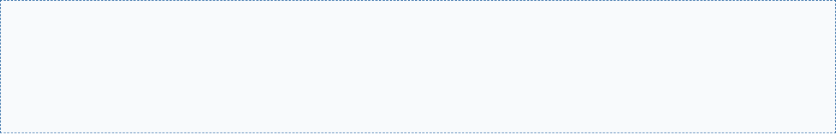

Thank You
Questions & Discussion
nizar.ho003@gmail.com
+20- 1115552118
DEPI Graduation Project | Real-Time Object Detection Slide 10

